Slide 1

Video Games reviews
Final EDA Project (TovTech) by Roman Fesunenko
© All rights reserved

Slide 2
Why I chose this topic of the project?
I make this EDA project as a part of Data Analyst course.
I found datasets in Kaggle and I came across specific dataset that more interesting for me.
Video games are became more popular in last decades by various categories of people.
Because I think that more people from different age groups are spending money and time for video games in recent decades.

Slide 3
What are data that I found during EDA project?
Total reviews: 47774 reviews.
Total video games: 40 video games
Total genres: 10 genres ("Action", "Adventure", "Fighting", "Party", "Puzzle", "RPG", "Shooter", "Simulation", "Sports" and "Strategy")
Total platforms: 5 platforms ("Xbox", "PlayStation", "PC", "Nintendo Switch" and "Mobile")
Total age groups: 4 age groups ("All ages", "Kids", "Teens", "Adults")

Slide 4
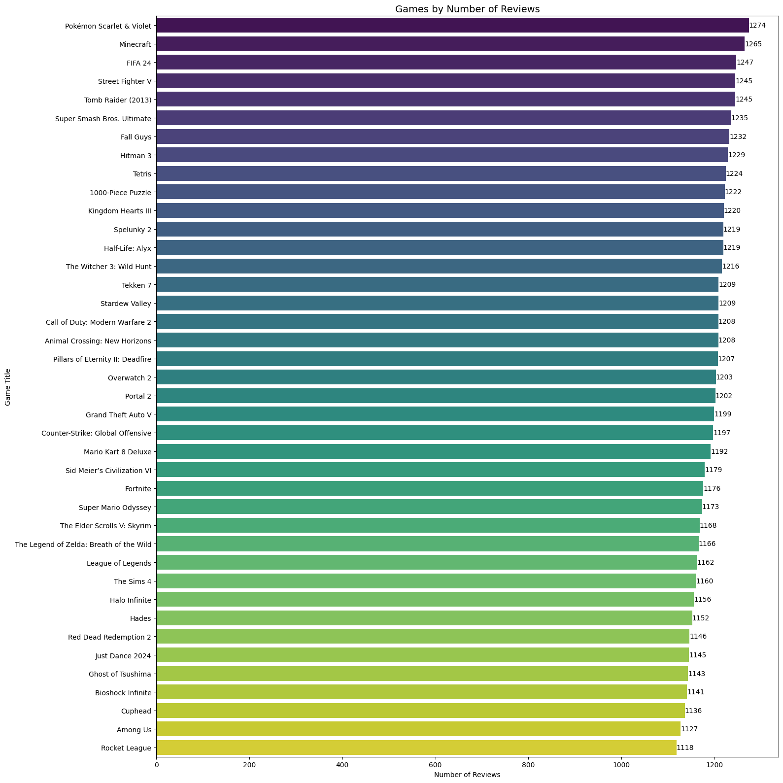
Total number of games by reviewers
There have total 40 video games.
Most popular game is 'Pokemon Sсarlet & Violet' with 1274 reviewers.
TOP-5 popular games are 'Pokemon Sсarlet & Violet', 'Minecraft', 'FIFA 24', 'Street Fighter V' and 'Tomb Raider (2013)'
Least popular game is 'Rocket League' with 1118 reviewers.

Slide 5
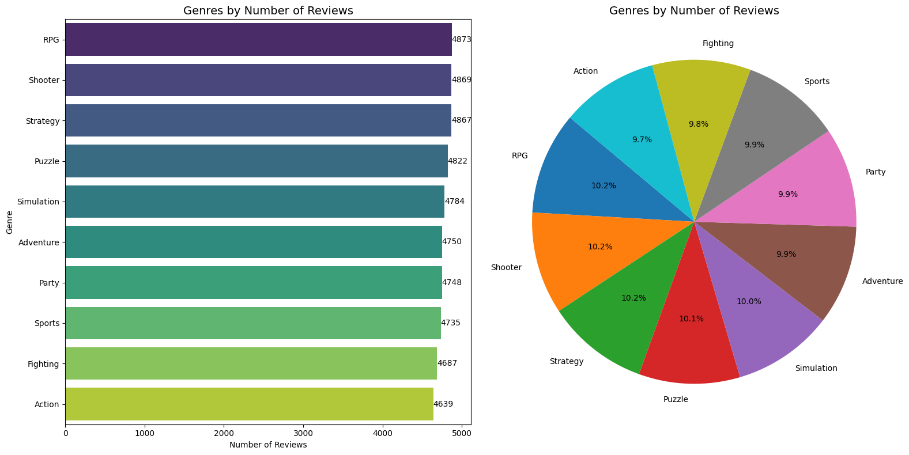
Total number of genres by reviewers
There have total 10 genres.
Most popular genre is RPG with 4873 reviewers (9.7% of reviewers).
TOP-5 popular genres are RPG, Shooter, Strategy, Puzzle and Simulation.
Least popular genre is Action with 4639 reviewers (9.7% of reviewers).

Slide 6
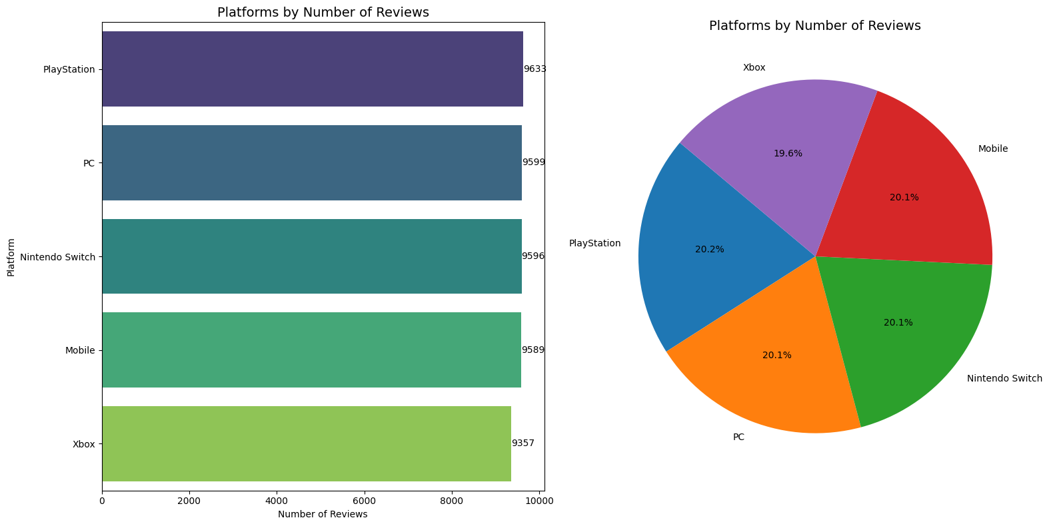
Total number of platforms by reviewers
There have total 5 platforms.
Most popular platform is Playstation with 9633 reviewers (20.2% of reviewers).
TOP-5 popular platforms are PlayStation, PC, Nintendo Switch, Mobile and Xbox.
Least popular platform is Xbox with 9357 reviewers (19.6% of reviewers).

Slide 7
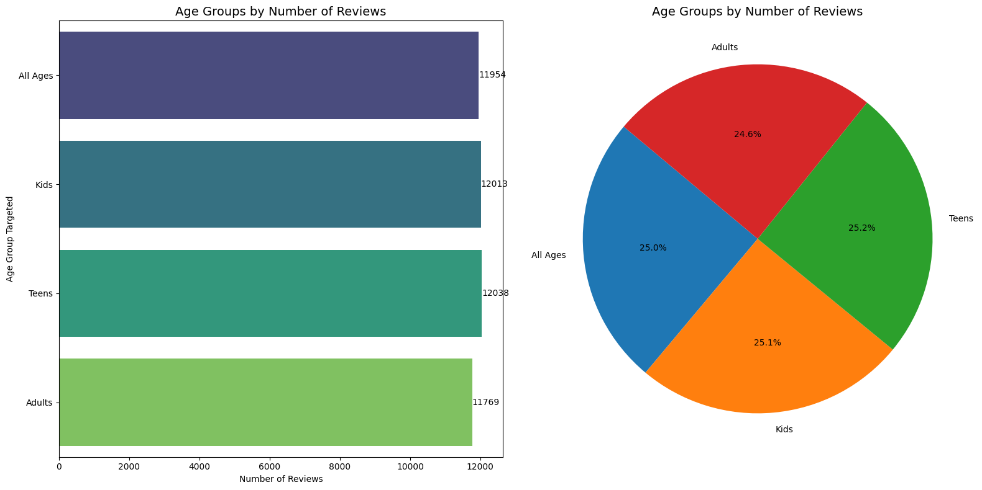
Total number of age groups by reviewers
There have total 4 age groups.
Most popular platform is Playstation with 9633 reviewers (20.2% of reviewers).
TOP-5 popular platforms are PlayStation, PC, Nintendo Switch, Mobile and Xbox.
Least popular platform is Xbox with 9357 reviewers (19.6% of reviewers).

Slide 8
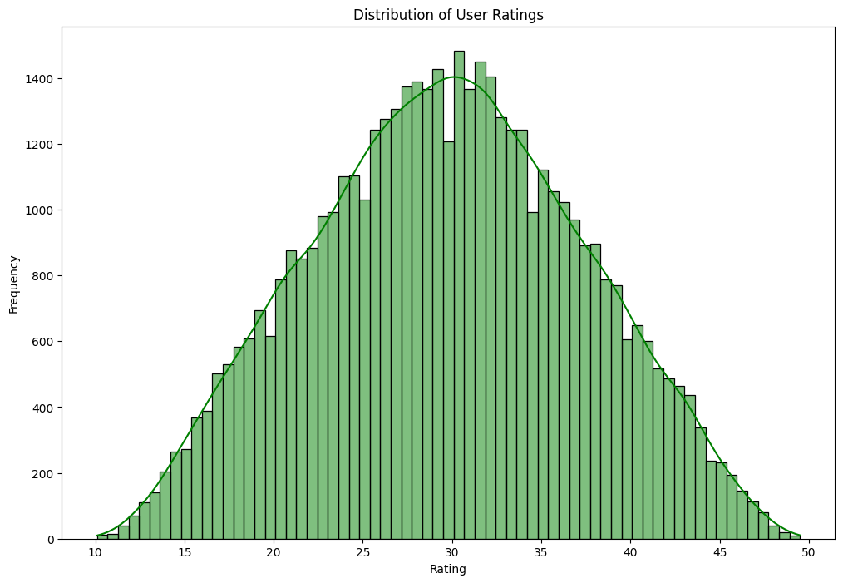
Distribution of user ratings
Average rating of reviews the games is 30.
Most popular reviews give rating of 30.
Least popular reviews give rating below to 15 or above from 45.

Slide 9
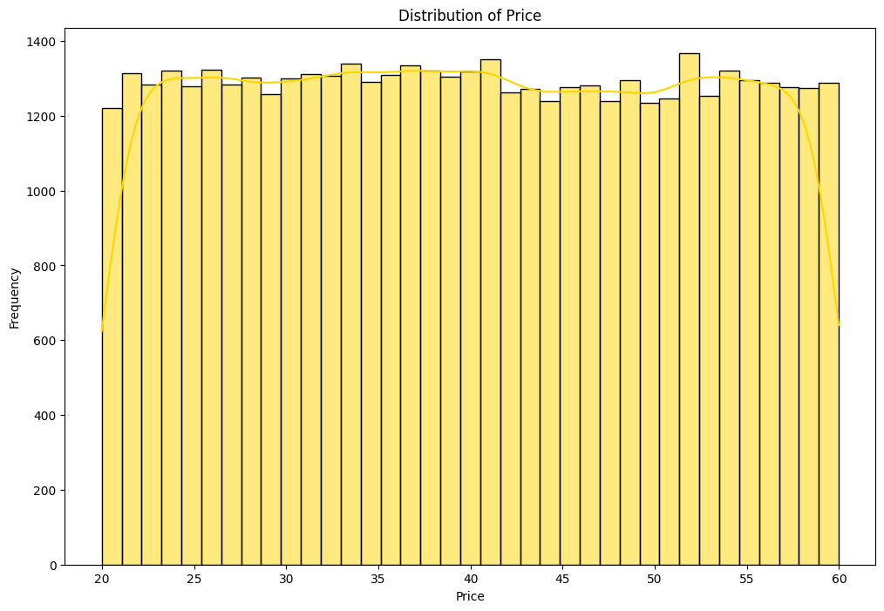
Distribution of price
Average price by reviews the games is 40$.
Most popular reviews reviewed games that cost 52$.
Least popular reviews reviewed games below to 25$ or above 55$.

Slide 10
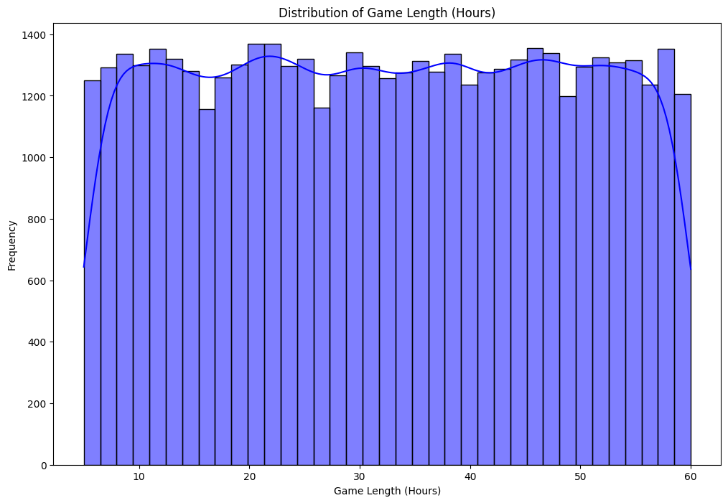
Distribution of game length (hours)
Average game hour is 35 hours.
Most popular reviews spent in average 35 hours.
Least popular reviews spent below to 10 hours or above 55 hours.

Slide 11
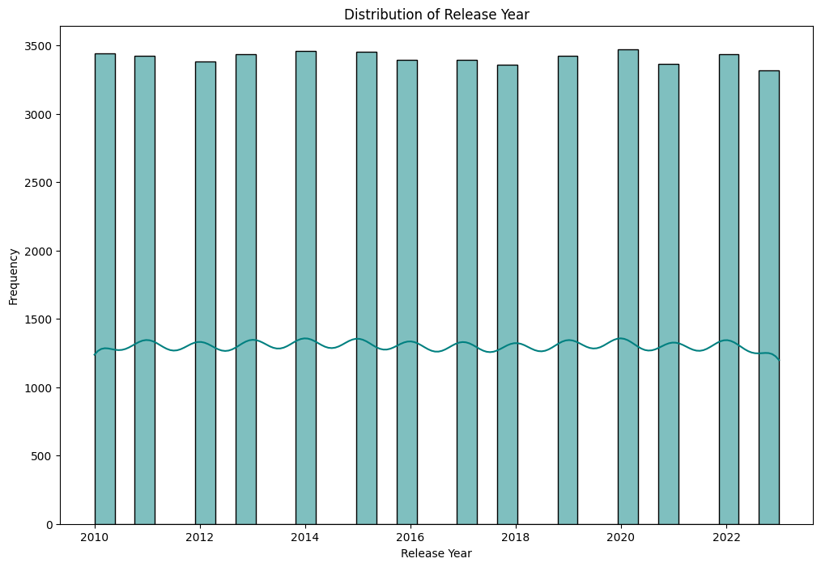
Distribution of release years
Number of game reviews of release year are same.
Average number reviews are 3500 reviews.

Slide 12
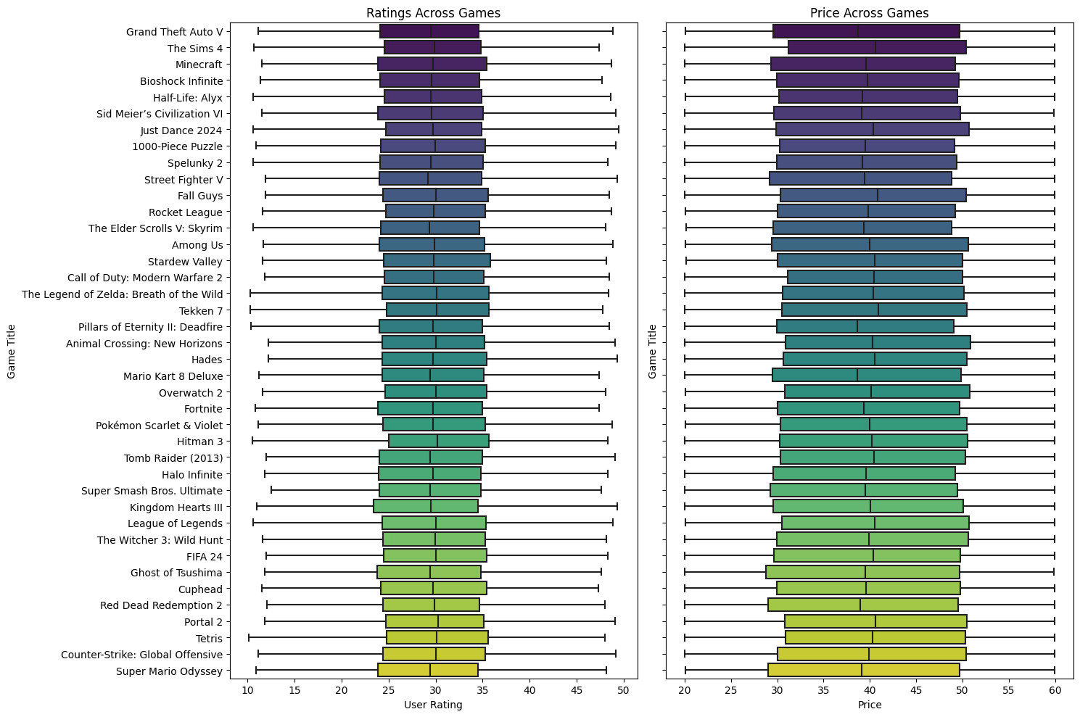
Video games by ratings and price
Rating:
Average rating games is 30.
Minimal rating games is 10.
Maximal rating games is 50.
Price:
Average price of games is 40$.
Minimal price of games is 20$.
Maximal price of games is 60$.

Slide 13
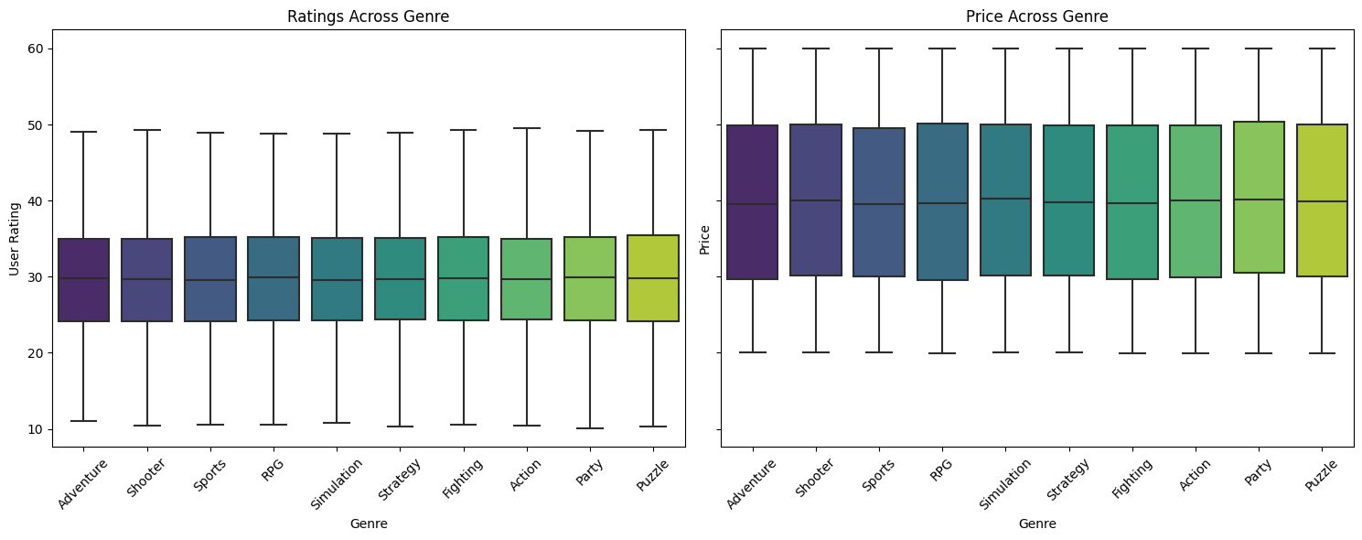
Genres by ratings and price
Average rating games by genre is 30.
Minimal rating games by genre is 10.
Maximal rating games by genre is 50.
Average price of games by genre is 40$.
Minimal price of games by genre is 20$.
Maximal price of games by genre is 60$.

Slide 14
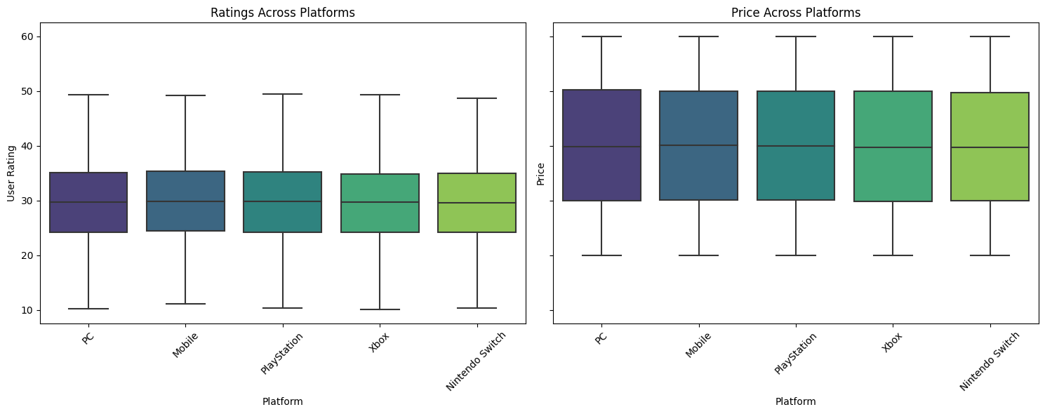
Platforms by ratings and price
Average rating games by platform is 30.
Minimal rating games by platform is 10.
Maximal rating games by platform is 50.
Average price of games by platform is 40$.
Minimal price of games by platform is 20$.
Maximal price of games by platform is 60$.

Slide 15
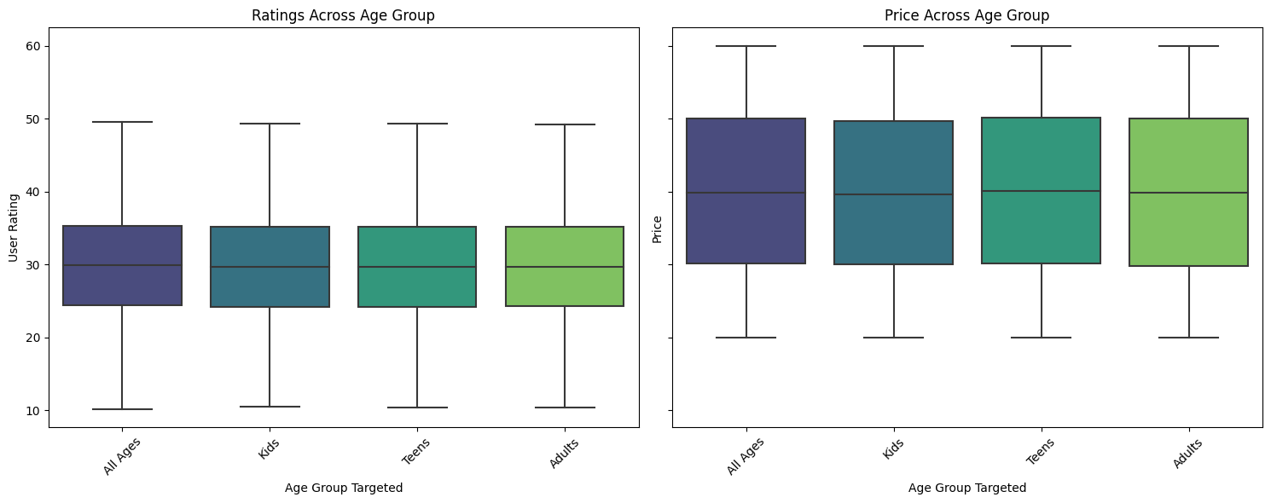
Age groups by ratings and price
Average rating games by age group is 30.
Minimal rating games by age group is 10.
Maximal rating games by age group is 50.
Average price of games by age group is 40$.
Minimal price of games by age group is 20$.
Maximal price of games by age group is 60$.

Slide 16
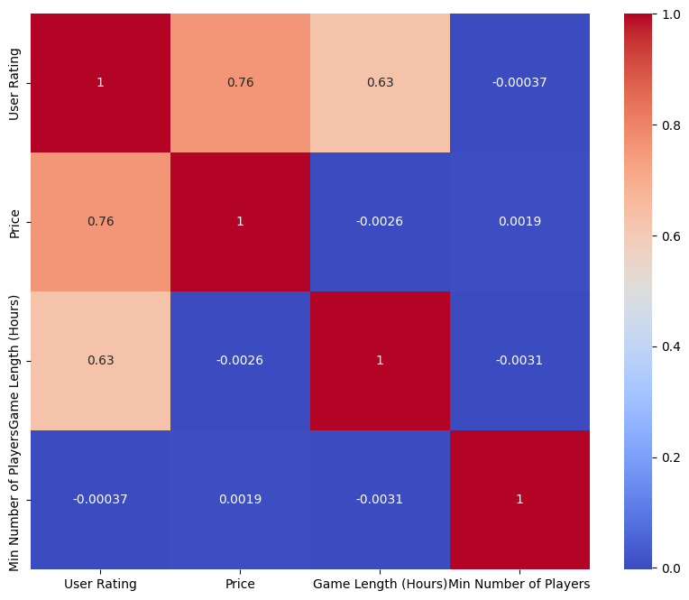
Relationships between numerical variables
User rating and price some association each other.
User rating, price and game length have littely association.
Min numbers of played doesn’t have association of other numeric columns.

Slide 17
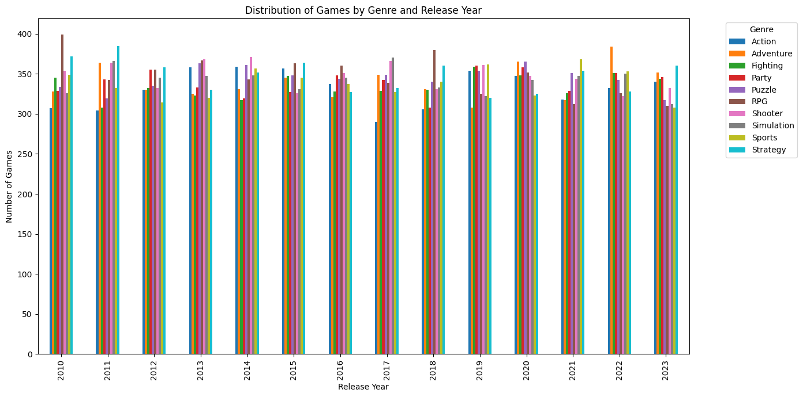
Distribution of games of genres with release years
Popularity for each genre is changes every year.
Most reviewed genre in 2010 is RPG. Least reviewed genre in 2010 is Action.
Most reviewed genre in 2015 is Strategy. Least reviewed genre in 2015 is Shooter.
Most reviewed genre in 2018 is RPG. Least reviewed genre in 2018 is Action.
Most reviewed genres in 2020 are Adventure and Puzzle. Least reviewed genre in 2020 is Sports.
Most reviewed genre in 2023 is Strategy. Least reviewed genres in 2023 are Sports and RPG.

Slide 18
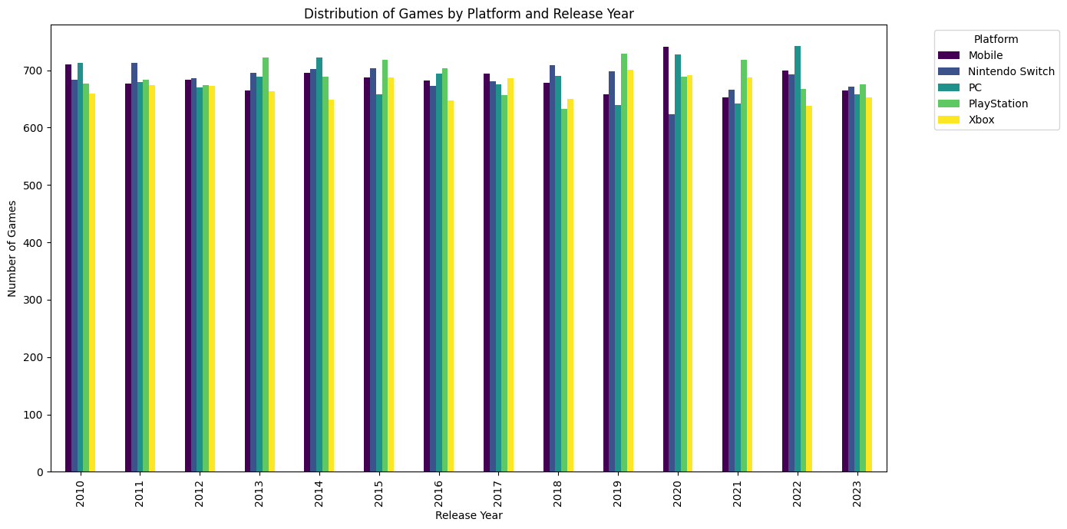
Distribution of games of platforms with release years
Popularity for each platform is changes every year.
Most reviewed platform in 2010 is PC. Least reviewed platform in 2010 is Xbox.
Most reviewed platform in 2015 is PlayStation. Least reviewed platform in 2015 is PC.
Most reviewed platform in 2018 is Nintendo Switch. Least reviewed platform in 2018 is PlayStation.
Most reviewed platform in 2020 is Mobile. Least reviewed platform in 2020 is Nintendo Switch.
Most reviewed platform in 2023 is PlayStation. Least reviewed platform in 2023 is Xbox.

Slide 19
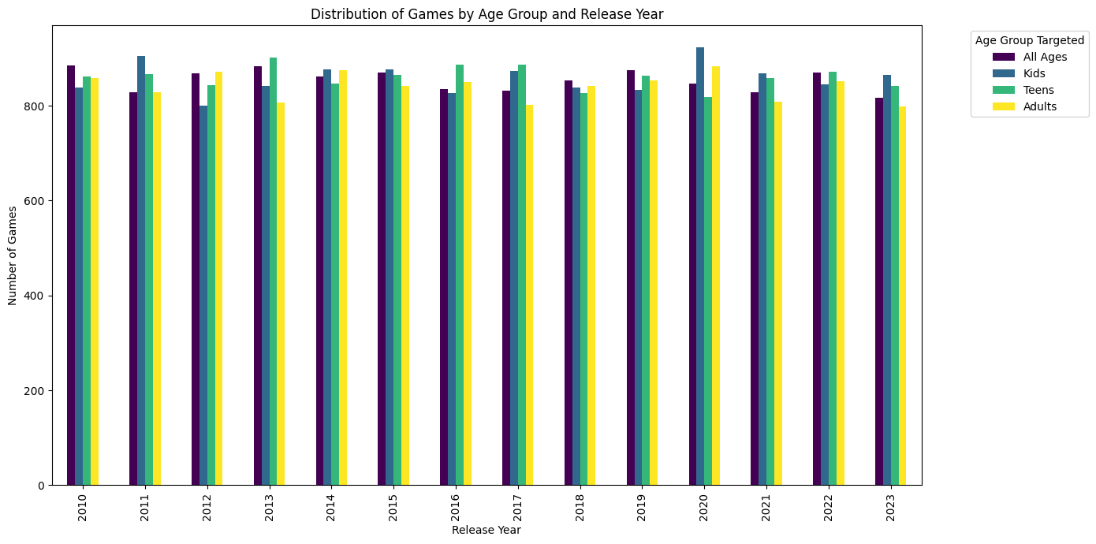
Distribution of games of age groups with release years
Popularity for each age group is changes every year.
Most reviewed age group in 2010 is All Ages. Least reviewed age group in 2010 is Kids.
Most reviewed age group in 2015 is Kids. Least reviewed age group in 2015 is Adults.
Most reviewed age group in 2018 is All Ages. Least reviewed age group in 2015 is Teens.
Most reviewed age group in 2020 is Kids. Least reviewed age group in 2020 is Teens.
Most reviewed age group in 2023 is Kids. Least reviewed age group in 2023 is Adults.

Slide 20
What are questions that I found during EDA project?
How do user ratings correlate with factors like price or completion time?
Are there any significant differences in user ratings for games released on different platforms (PC vs. Console vs. Mobile) per year?
Can we identify any patterns in user reviews based on the age group the game is targeted towards?
How does the sentiment of user reviews (positive, negative, neutral) differ across different game genres?

Slide 21
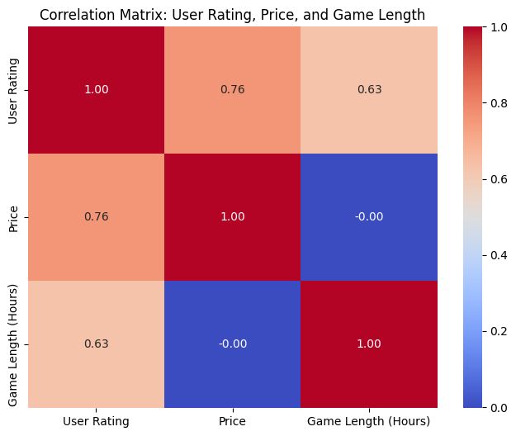
How do user ratings correlate with factors like price or completion time? (Part I)
User rating and price some association each other.
User rating have association with price and game length by hours.
Price doesn't have association with game length by hours.

Slide 22
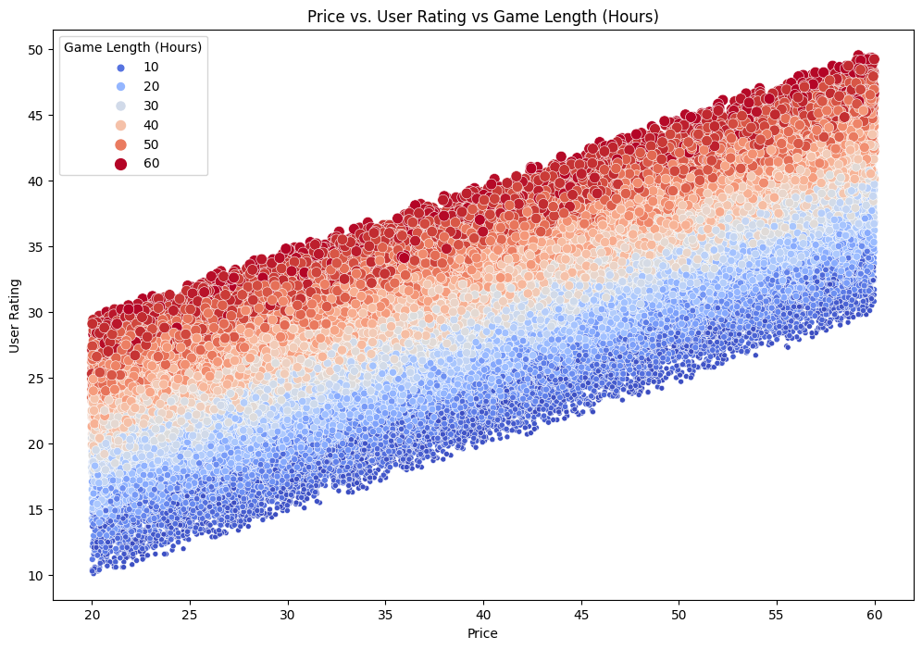
How do user ratings correlate with factors like price or completion time? (Part II)
Expensive video games taking to walkthrough the game is more hours than cheaper video games.
Video games with higher ratings cost expensive than games with lower rating.
Games with higher ratings taking to walkthrough the game is more hours than video games with lower ratings.

Slide 23
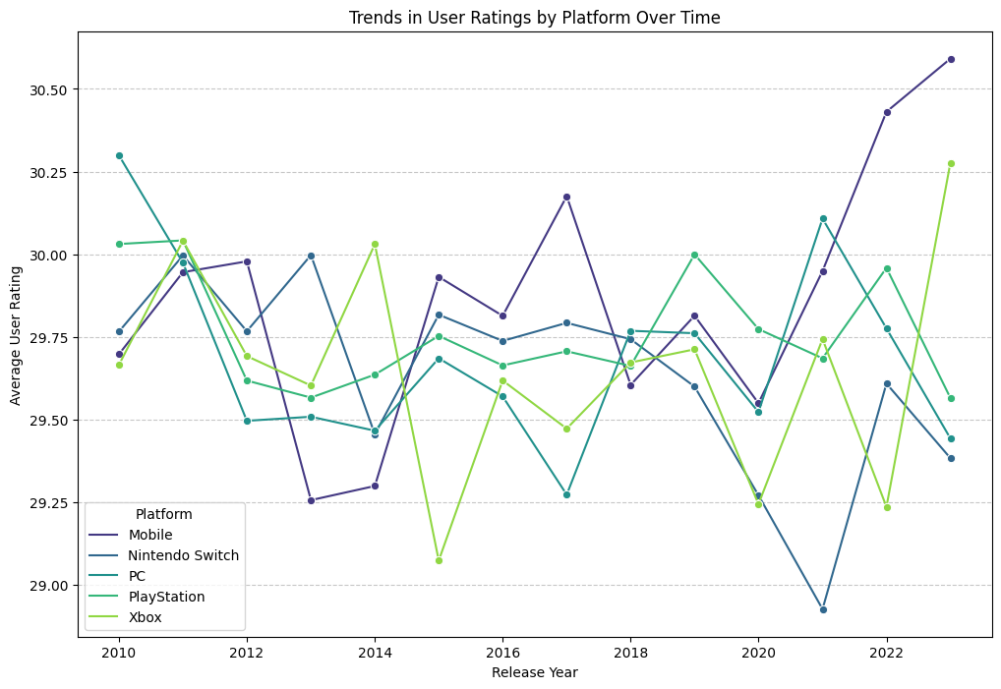
Are there any significant differences in user ratings for games released on different platforms (PC vs. Console vs. Mobile) per year?
Platform ratings are changing per year that some platform increasing rating and other platforms are decreasing rating.
Platform with highest rating in 2010 is PC. On other hand, platform with lowest rating in 2010 is Xbox.
Platform with highest rating in 2014 is Xbox. On other hand, platform with lowest rating in 2014 is Mobile.
Platform with highest rating in 2017 is Mobile. On other hand, platform with lowest rating in 2017 is PC.
Platform with highest rating in 2021 is PC. On other hand, platform with lowest rating in 2021 is Nintendo Switch.
Platform with highest rating in 2023 is Mobile. On other hand, platform with lowest rating in 2023 is Nintendo Switch.
It seems that mobile games got higher rating, because games for mobile device that using more in recent years become more popular.

Slide 24
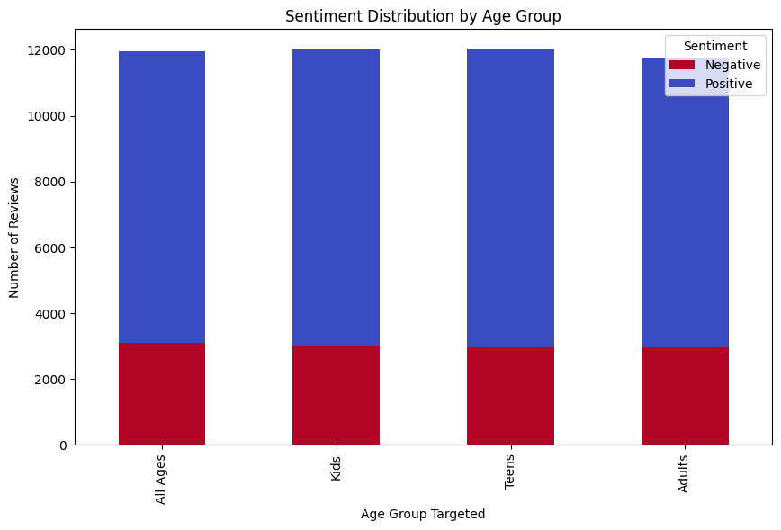
Can we identify any patterns in user reviews based on the age group the game is targeted towards?
It seems that 1/4 of reviewers of games of each age group targeted are from different age group.
It seems that 1/4 of reviewers feel that games that age group targeted are not necessarily appropriate for an age group.
Most of reviews of video games are reviewers from same age group.

Slide 25
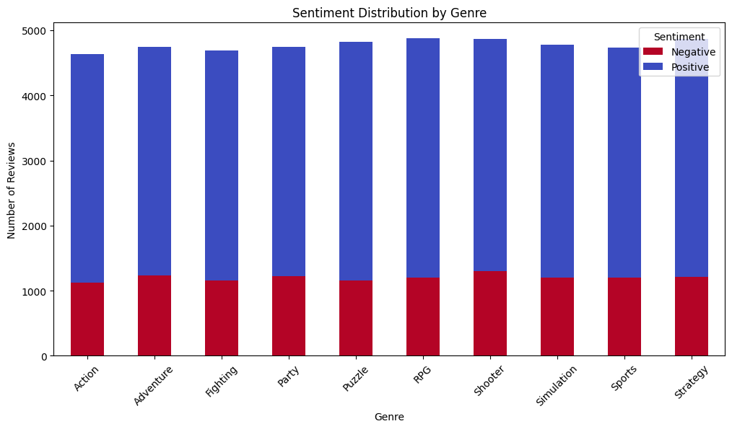
How does the sentiment of user reviews (positive, negative, neutral) differ across different game genres?
It seems that 1/4 of reviewers of video games of each genre disappointed by game experiences in game.
It seems that most of reviews of video games of each genre more liked to review their genre.
Every reviewer have different ratings in every video games.

Slide 26
What are significant insights and recommendations during EDA project?
Each reviewer have different experience during the playing the game.
Price and count of walkthrough hours may cause to quality of the game and also causes to rating of review.
Not every reviewer reviewed game that belongs to his age targeted group.
Some reviewers liked more specific game genre or game platform.
Trends of platform of video games are change during last decades.
Games for mobile became more popular in last years, and it seems that these kind of games became profitable.
Genres popularity changes every year, that depends on which one is more profitable.

Slide 27
Additional links:
Dataset in Kaggle:
https://www.kaggle.com/datasets/jahnavipaliwal/video-game-reviews-and-ratings
Jupyter notebook in Kaggle:
https://www.kaggle.com/code/superroman19/eda-project-tovtech-video-game-reviews
GitHub repository:
https://github.com/IrronRoman19/final-project-data

Slide 28

Questions?

